Slide 1
LICENSE, FEDORA, UBUNTU

Slide 2
FREE SOFTWARE LICENSE PROVIDER
GPL
LGPL
BSD LICENSE (Berkeley Software Distribution)
MIT license (Massachusetts Institute of Technology)
Apache license

Slide 3
GPL : A copyleft license that requires any derivative works to also be licensed under the GPL, making it difficult to use GPL-licensed code in proprietary software.
LGPL (GNU Lesser General Public License): Similar to the GPL, but allows for linking with non-GPL code under certain conditions.
BSD (Berkeley Software Distribution) Licenses: A permissive license that allows for free use, modification, and distribution of the software, with few restrictions. Some popular software projects that are released under the BSD license include the FreeBSD operating system, the OpenBSD operating system, and the Nginx web server.
The MIT License allows anyone to use, copy, modify, merge, publish, distribute, sublicense, and/or sell copies of the software without restriction, provided that the original copyright notice and disclaimer are included in all copies or substantial portions of the software. The MIT License has been used by many popular software projects, including jQuery, Node.js, and Ruby on Rails

Slide 4
What is the FSF (Free Software Foundation)?
The Free Software Foundation (FSF) is a nonprofit organization that promotes and defends free software. It was founded by Richard Stallman in 1985 and is responsible for maintaining the GNU General Public License (GPL).

Slide 5
FSF Actively Enforces GPL
FSF ensures that software licensed under the GNU GPL is properly followed.
If someone violates GPL (e.g., by distributing software without source code), FSF may take legal action or negotiate compliance.
FSF also runs the GPL Compliance Lab, which helps developers and companies follow the license correctly.

Slide 6
FSF Does NOT Enforce BSD or MIT Licenses
BSD and MIT licenses are permissive and do not require keeping software open-source.
Since they allow proprietary modifications, FSF does not monitor or enforce them.

Slide 7
What Can FSF Do If Someone Violates GPL?
Investigation: FSF looks into reported GPL violations
Contacting Violators: They reach out to companies or individuals violating the GPL.
Legal Action (if needed): If violators refuse to comply, FSF can help take legal action.
Ensuring Future Compliance: The goal is to educate, not punish—FSF helps violators fix the issue rather than immediately suing them.

Slide 8
Apache license: A permissive license that allows for free use, modification, and distribution of the software, but also includes patent protection clauses and some attribution requirements.
The Apache License is compatible with the GNU General Public License (GPL), which means that software licensed under the Apache License can be combined with GPL licensed software.
The Apache License has been used by many popular software projects, including the Apache web server, Hadoop, and Lucene.

Slide 9
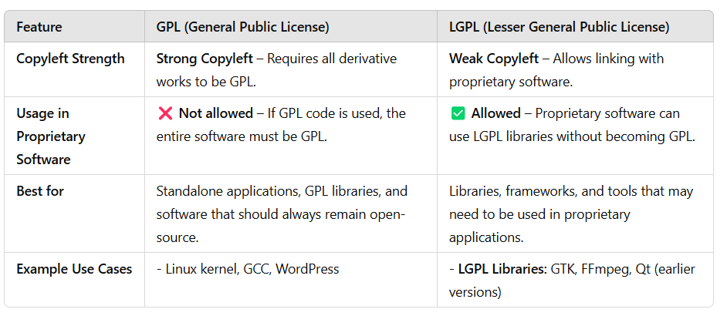
GPL vs. LGPL – Key Differences

Slide 10
Open Source Operating Systems
FEDORA
UBUNTU

Slide 11
FEDORA
Fedora is a Linux-based operating system that is developed by the community-supported Fedora Project, sponsored by Red Hat. Fedora is known for its cutting-edge features and its focus on innovation.
The operating system is updated frequently with new features and security updates, making it a great choice for users who want to stay on the cutting edge of technology.
One of the standout features of Fedora is its focus on open source software. Fedora only includes software that is released under an open source license, which means that users can modify and distribute the software freely. Additionally, Fedora is known for its security features, including SELinux and kernel hardening, which help to make the operating system more secure.

Slide 12
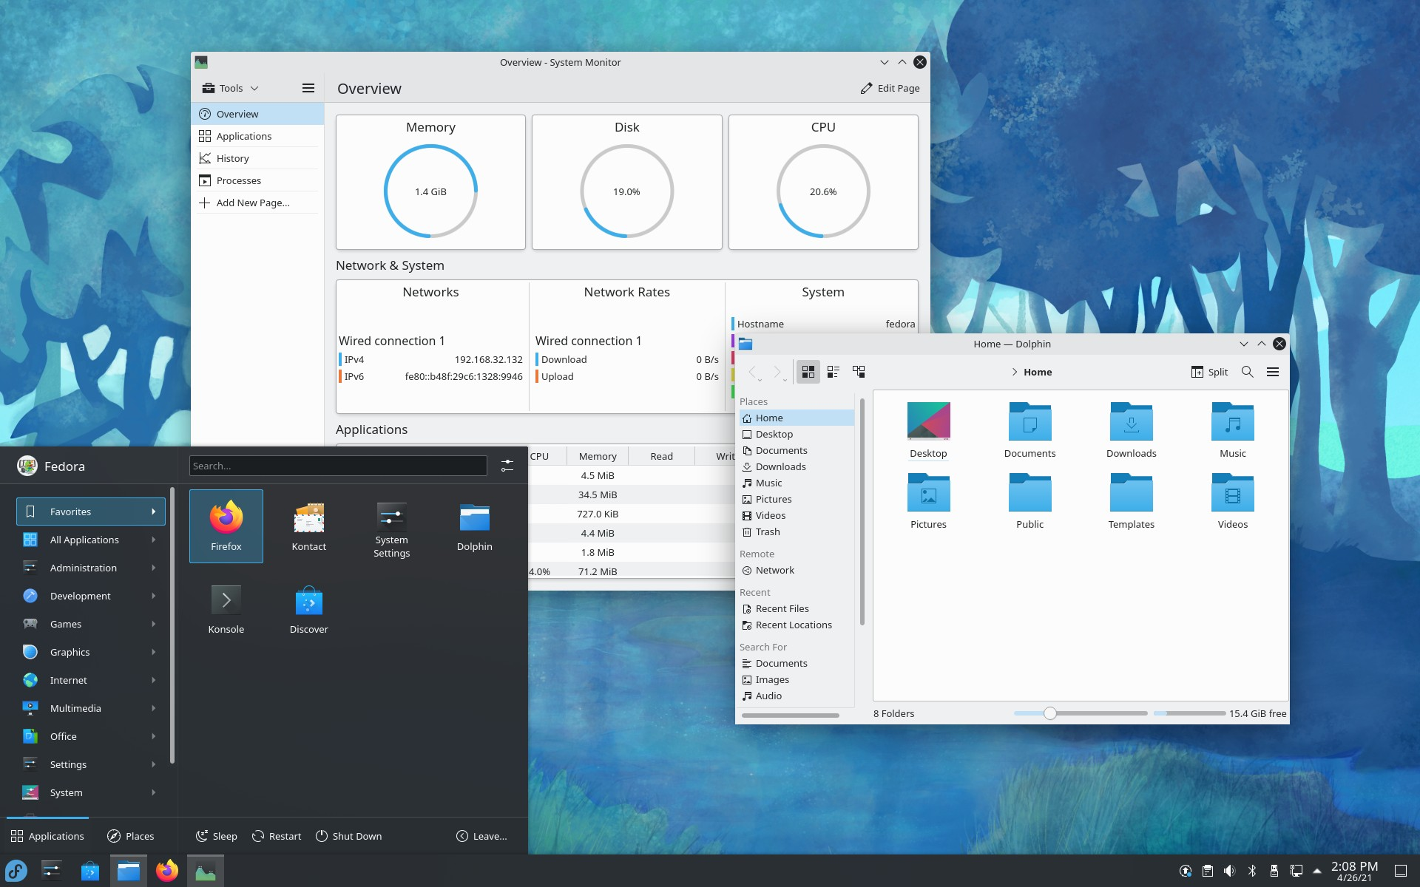

Slide 13
Ubuntu
Ubuntu, on the other hand, is another Linux-based operating system that is known for its ease of use and user-friendly interface. Ubuntu is developed by Canonical and is based on the Debian Linux distribution. Unlike Fedora, Ubuntu is designed to be stable and reliable, with new releases being released every six months.
One of the standout features of Ubuntu is its focus on user experience. The operating system includes a wide range of software and tools that are designed to make it easy for users to get started with Linux, including a software center that allows users to download and install software with just a few clicks. Additionally, Ubuntu includes the Unity desktop environment, which provides a modern and user-friendly interface.

Slide 14
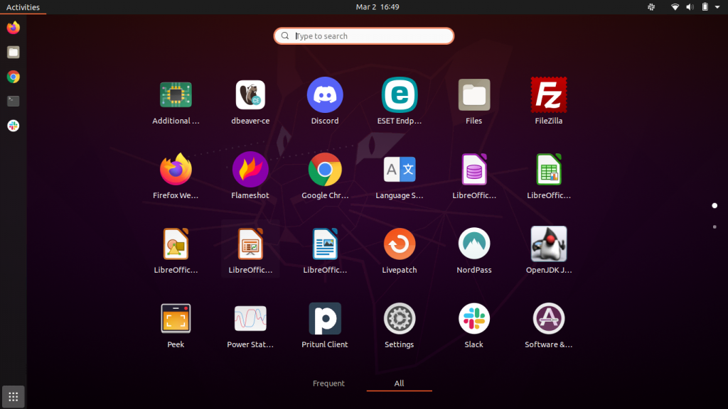

Slide 15
S.NO. | Ubuntu | Fedora
1. | Ubuntu is a Debian Based OS. | Fedora is a community based project by Redhat.
2. | Ubuntu was initially released in October 2004. | Fedora was initially released in November 2003.
3. | Ubuntu allows one-click installation for nvidia graphics driver. | It is a bit complicated and hard to install nvidia graphics driver in fedora.
4. | Ubuntu uses Ubiquity installer for installing Ubuntu. | Fedora uses anaconda installer for installing Fedora.
5. | Ubuntu uses apt, dkpg, package manager. | Fedora uses DNF, RPM, YUM package manager.

Slide 16
6. | Some of the popular applications of Ubuntu are- LibreOffice, Rhythmbox, Steam, Shotcut etc. | Some of the popular applications of Fedora are- Signal, Mozilla Firefox, LibreOffice, Dolphin File Manager etc.
7. | Ubuntu has 2 forums for duscussion ubuntuforums.org and askubuntu.com | Fedora has only 1 forum for discussions which is ask.fedoraproject.org

Slide 17
What type of operating system is Fedora?
A. Proprietary
B. Closed-source
C. Open-source
D. Commercial

Slide 18
What is the default desktop environment for Ubuntu?
A. KDE Plasma
B. GNOME
C. Xfce
D. Cinnamon
GNOME stands for "GNU Network Object Model Environment." It is a free and open-source desktop environment primarily used in Linux-based operating systems. GNOME provides a graphical user interface (GUI) and a set of applications to create a user-friendly computing experience. It is developed by the GNOME Project and is known for its simplicity, modern design, and accessibility features

Slide 19
What package manager does Fedora use?
A. Apt - Advanced Package Tool
B. Yum - Yellowdog Updater, Modified
C. Pacman - package manager
D. Dnf - Dandified

Slide 20
Which of the following is a Ubuntu flavor?
A. Ubuntu Edge
B. Ubuntu Core
C. Kubuntu
D. Ubuntu One

Slide 21
What is the default package manager for Ubuntu?
A. Yum
B. Apt
C. Pacman
D. Dnf

Slide 22
What is the default shell for Ubuntu?
A. Bash - Bourne Again Shel Default for many Linux
B. Zsh - Z shell Default in macOS
C. Fish Friendly Interactive Shell unix
D. PowerShell - windows

Slide 23
Which of the following is a command-line package manager for Fedora?
A. Apt
B. Yum
C. Pacman
D. Dnf

